Slide 1
CSE 215L: Programming Language II Lab Faculty: Silvia Ahmed, Sec – 12, 13
Lab 6 – Summer 2020

Slide 2
UML Diagram
A class is represented by a box with up to three sections: the top contains the class name; the middle contains the fields; the bottom contains the methods. Consider the following Java class definition, a ridiculously-designed example that will serve to demonstrate core UML data representations.
public class Example {
private int x;
protected int y;
public int z;
public Example() { ... }
public String toString() { ... }
private void foo(int x) { ... }
protected int bar(int y, int z) { ... }
}

Slide 3
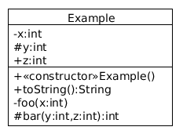
This can be represented with the following class diagram.
The fields and methods are annotated to indicate their access level: plus (+) for public, minus (-) for private, and hash (#) for protected. UML conventionlly uses Algol-style naming, so variables are given as name:type and methods are given as name(params):type, where each parameter is, of course, a variable.

Slide 4
Static members in class diagrams are underlined, and abstract elements are italicized. Constant (i.e. final) fields are indicated via naming convention: constants should be in ALL_CAPS. Here is another code and diagram example.
public abstract class Example2 {
public static final double PI = 3.14;
public abstract void foo() { ... }
protected void bar() { ... }
}

Slide 5


Interfaces are given the «interface» annotation, as shown below.
public interface FooListener {
public void foo();
}

Slide 6
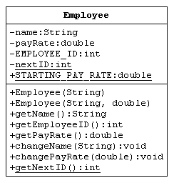
Example UML

Slide 7
Java class
public class Employee {
private String name;
private double payRate;
private final int EMPLOYEE_ID;
private static int nextID = 1000;
public static final double STARTING_PAY_RATE = 7.75;
public Employee(String name) {
this.name = name;
EMPLOYEE_ID = getNextID();
payRate = STARTING_PAY_RATE;
}

Slide 8
public Employee(String name, double startingPay) {
this.name = name;
EMPLOYEE_ID = getNextID();
payRate = startingPay;
}
public String getName() { return name; }
public int getEmployeeID() { return EMPLOYEE_ID; }
public double getPayRate() { return payRate; }
public void changeName(String newName) { name = newName; }
public void changePayRate(double newRate) { payRate = newRate; }
public static int getNextID() {
int id = nextID;
nextID++;
return id;
}
}

